Slide 1


Stop wasting time on data typing!
@CWaggershauser

Slide 2
Disclaimer:
Based in user experience alone

Slide 3


Epicollect5 is 100% free and limitless*
Open Source
Uses Google accounts
Holds only your email
Data ownership retained by project manager
Giving access to a third person = explicit access to data
Daily back-ups
(*) Within fair use policy

Slide 4
Record
Upload
Download

Slide 5
Limitations
Requires an expensive phone
Water and shock-proofing is a must
Daily access to power sources
Frequent access to the internet for data uploading

Slide 6
How does it work?
In 101 simple steps!

Slide 7


First you need a Google account

Slide 8
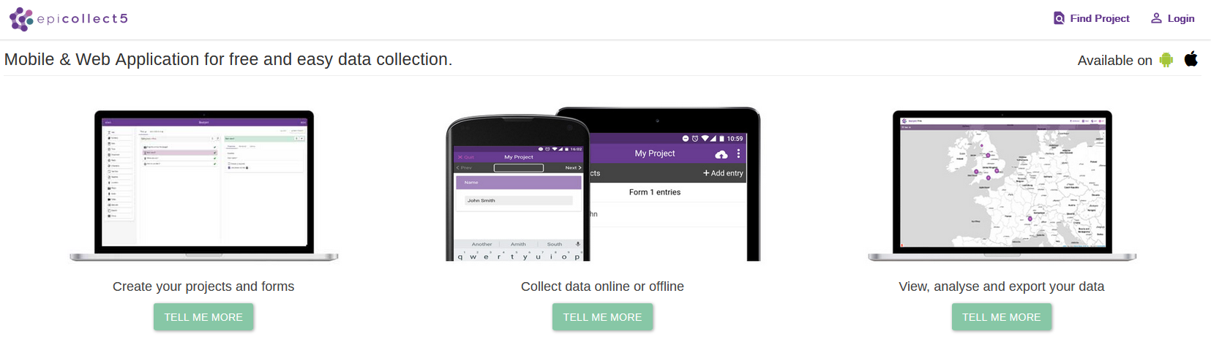
You can use it to login at Epicollect5

Slide 9
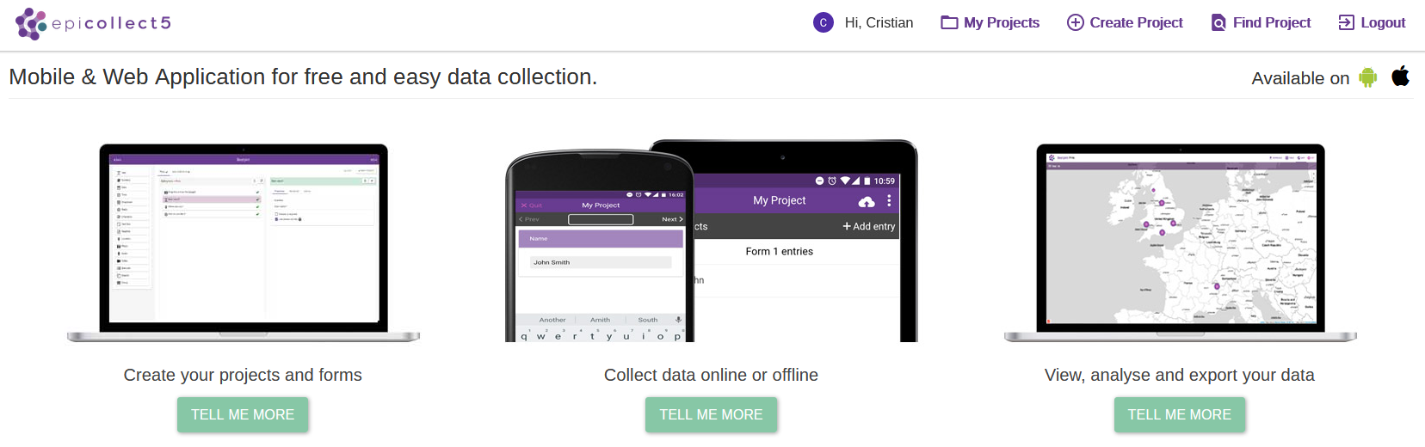
Ready to create a new project

Slide 10
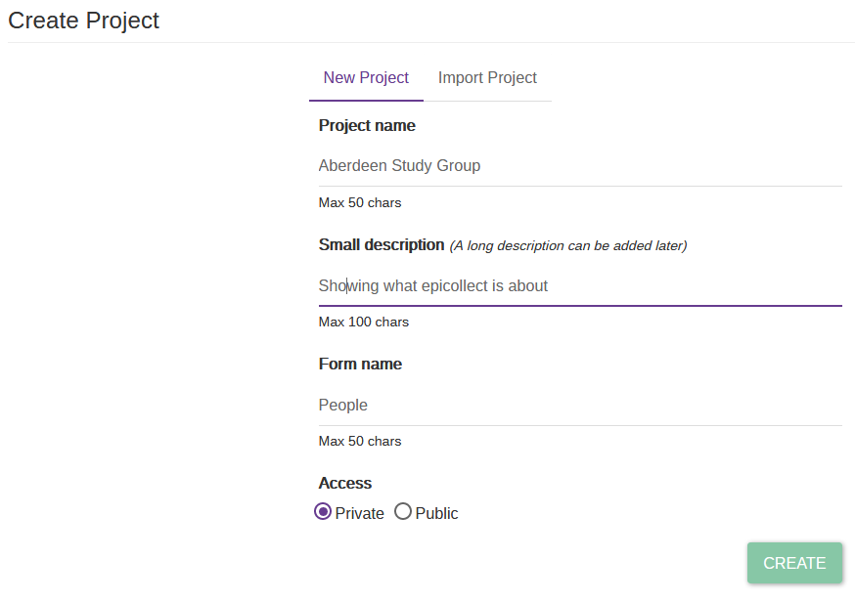
Add in your project’s details

Slide 11
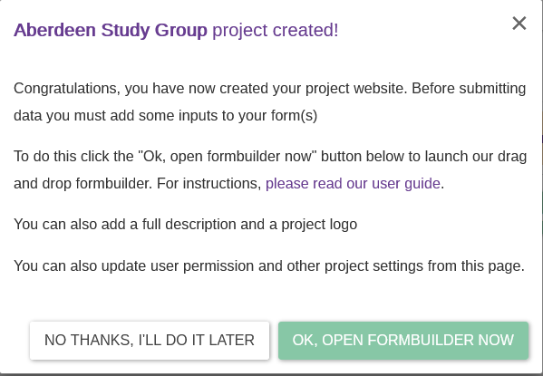
Congratulations!

Slide 12
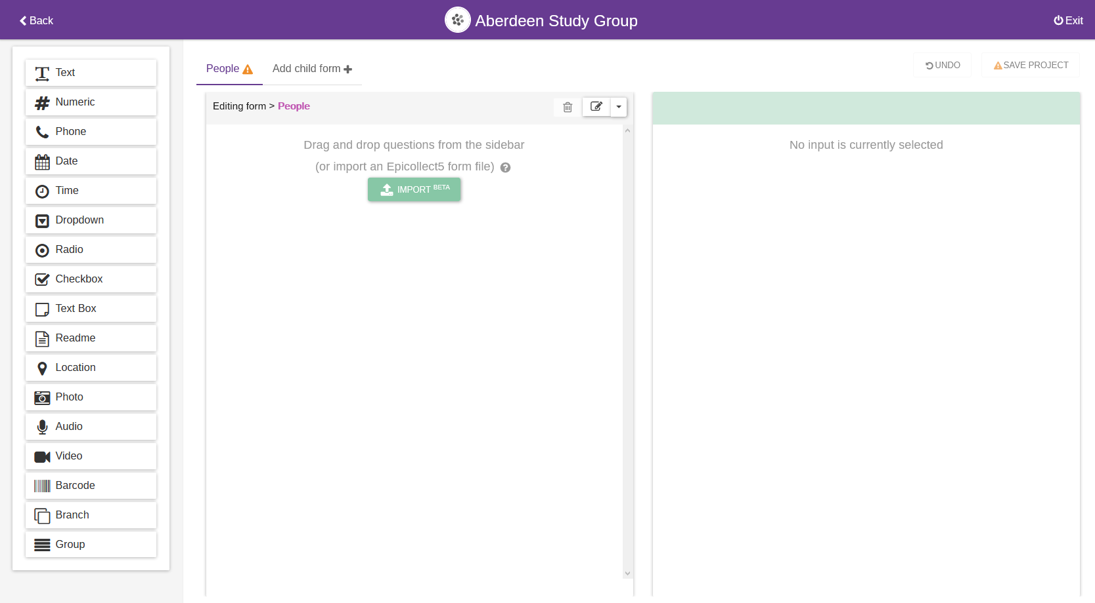
The Form Builder is your friend

Slide 13
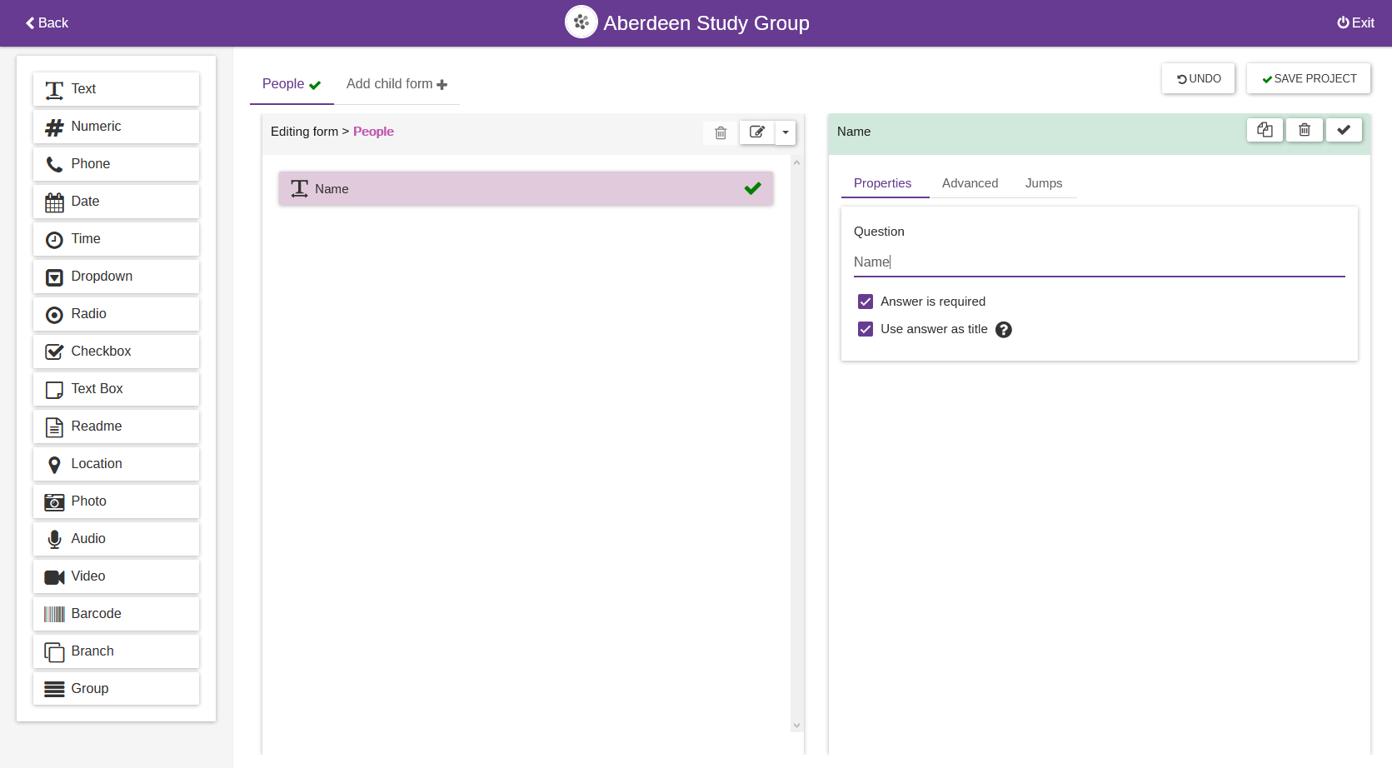
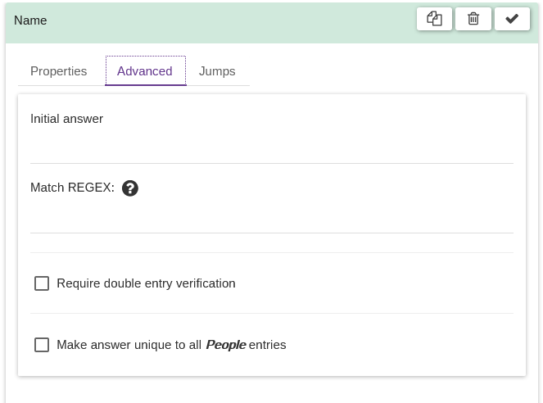

Slide 14
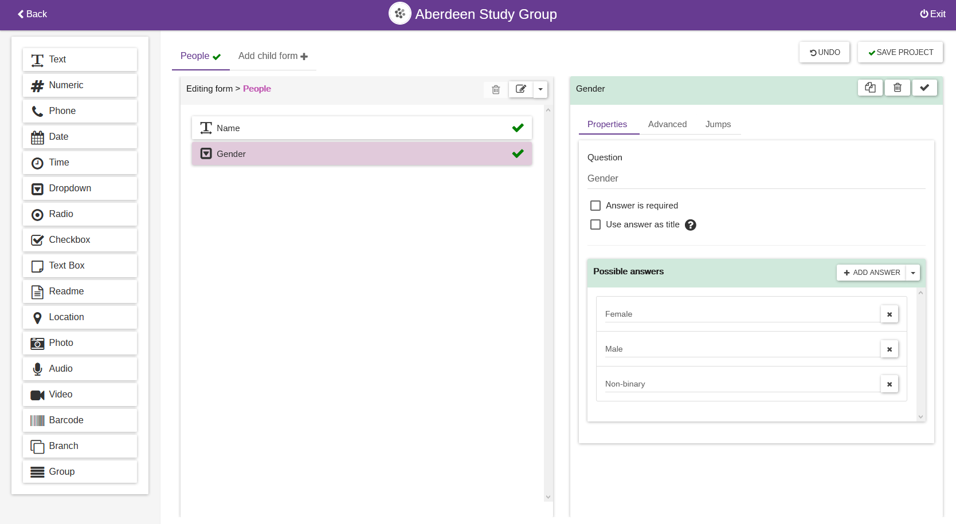

Slide 15
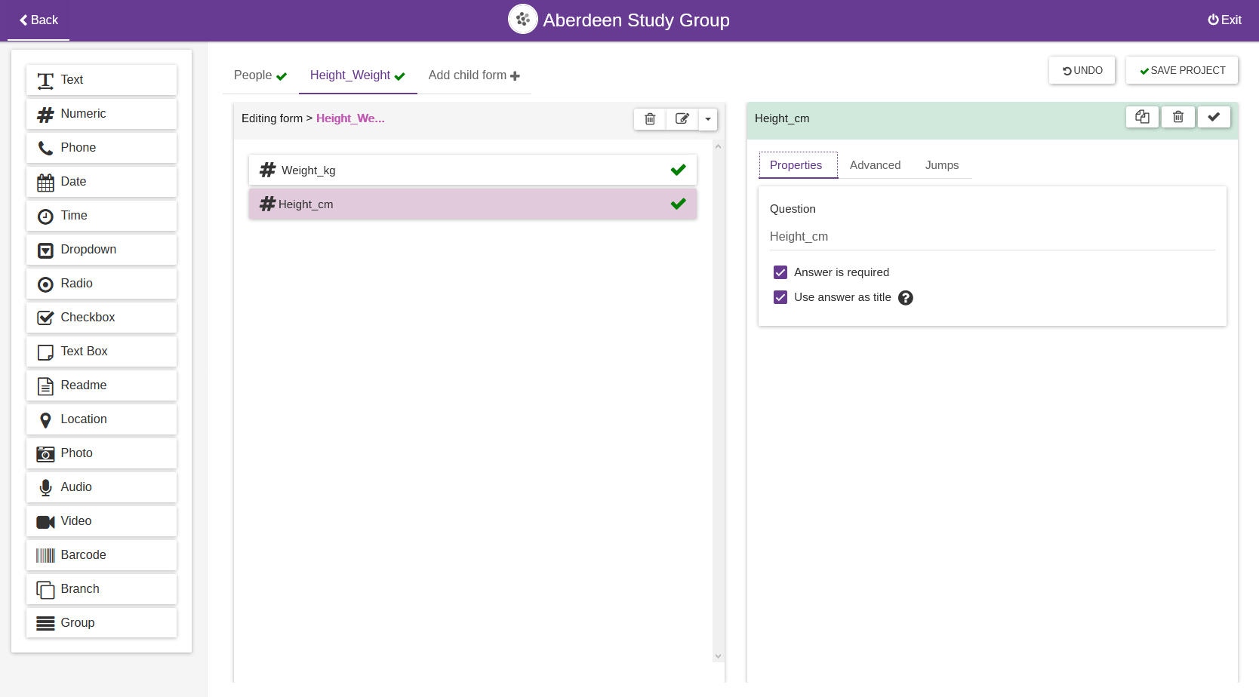
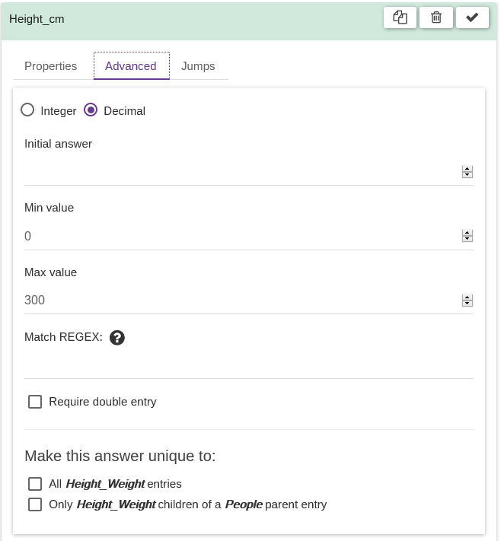

Slide 16
BEWARE! Think twice before making changes

Slide 17
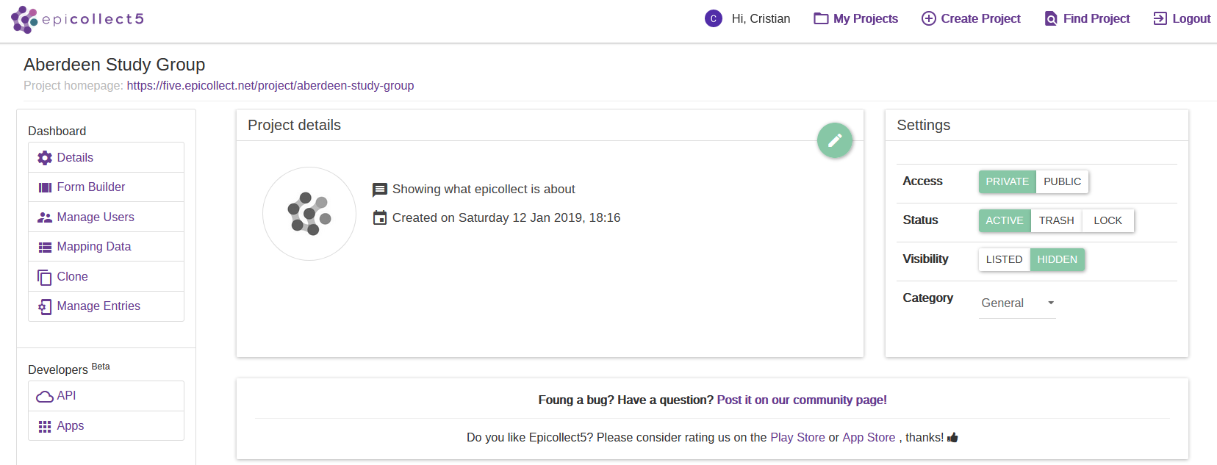
That’s it! Now go out there!

Slide 18
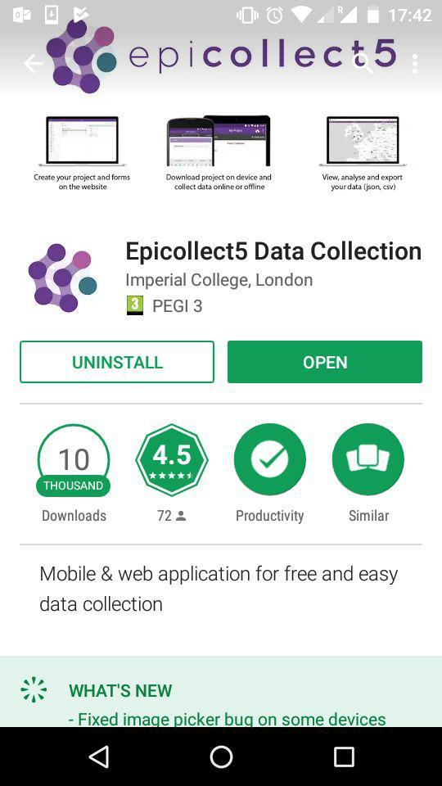
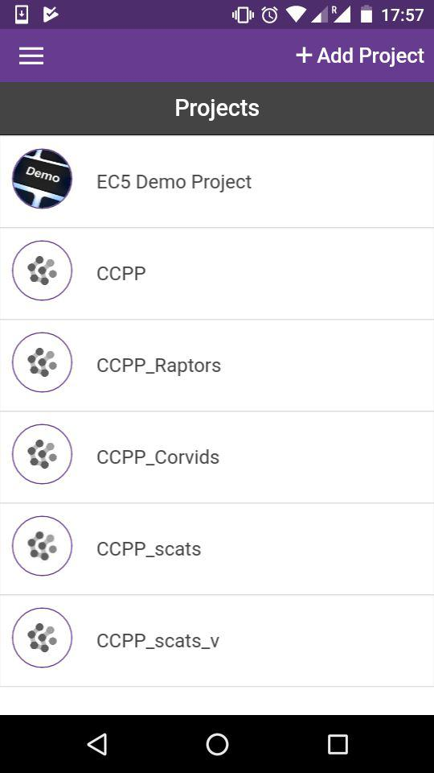
Download the app
Login

Slide 19
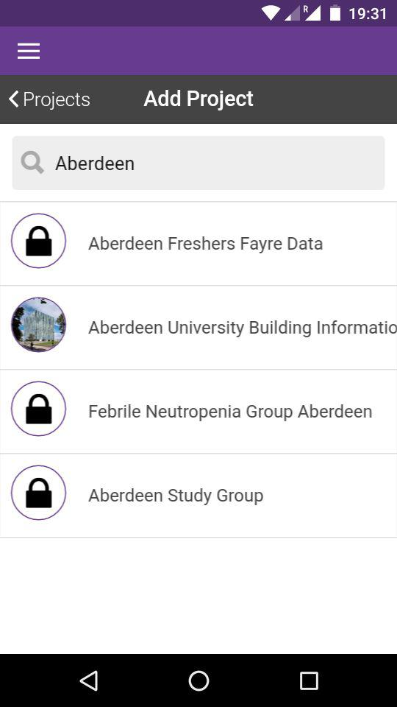
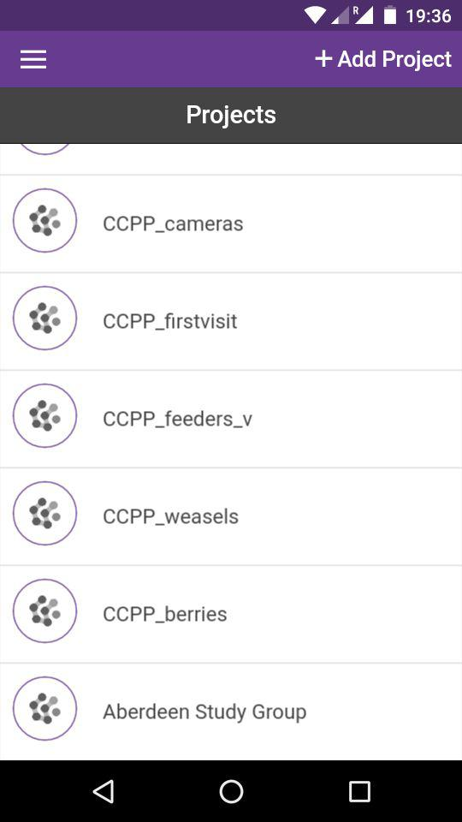
Add project

Slide 20
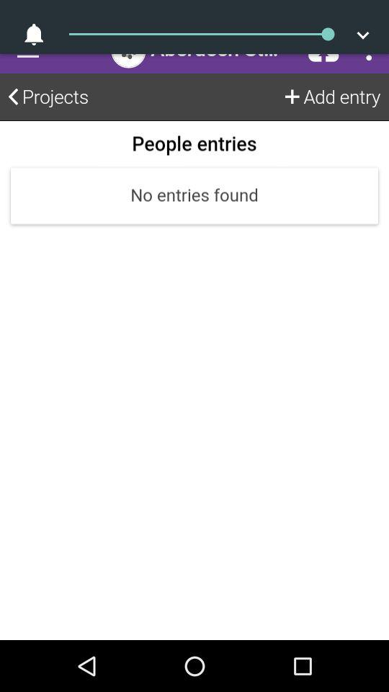
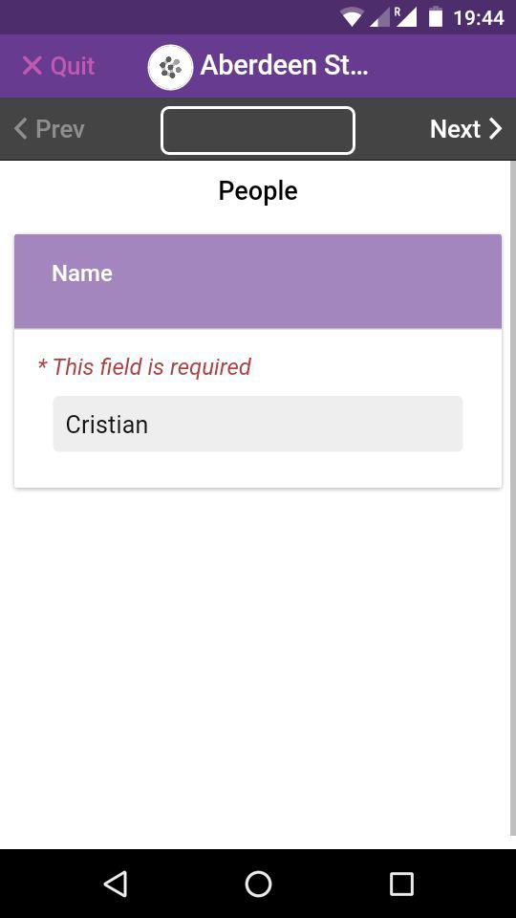
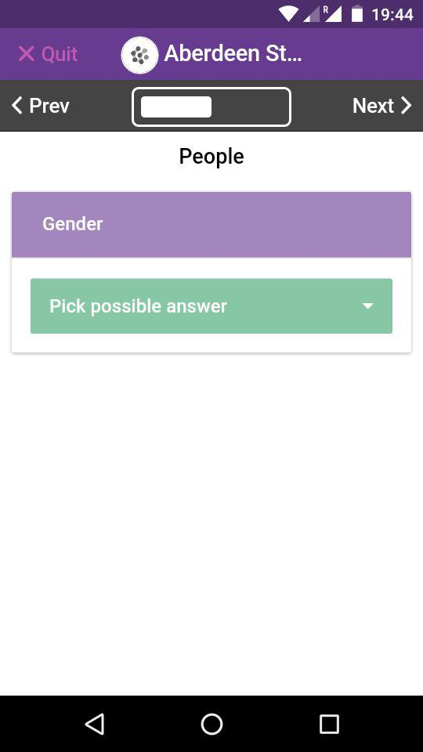
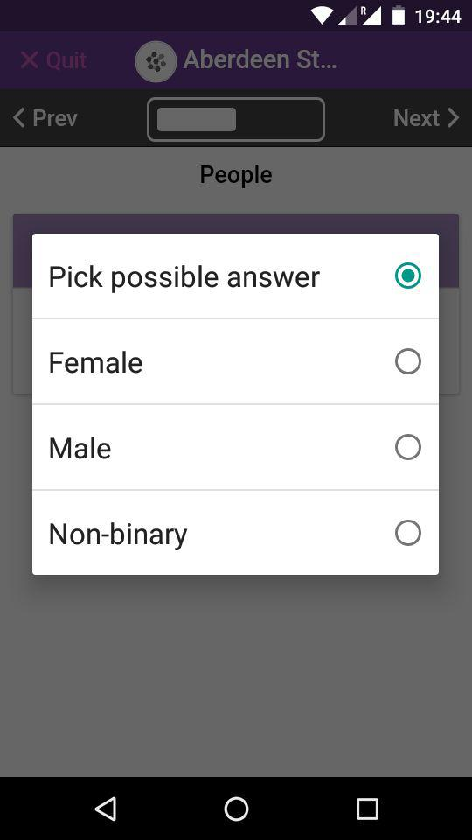
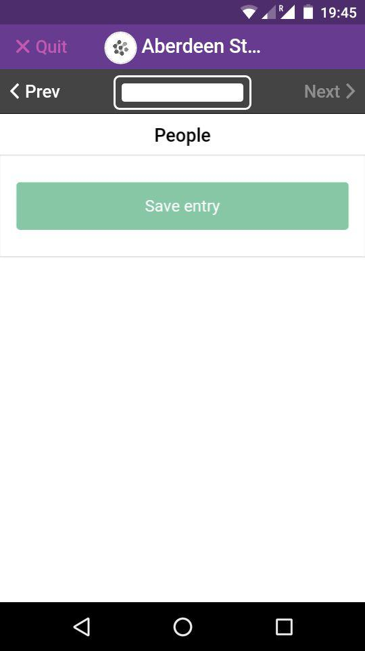
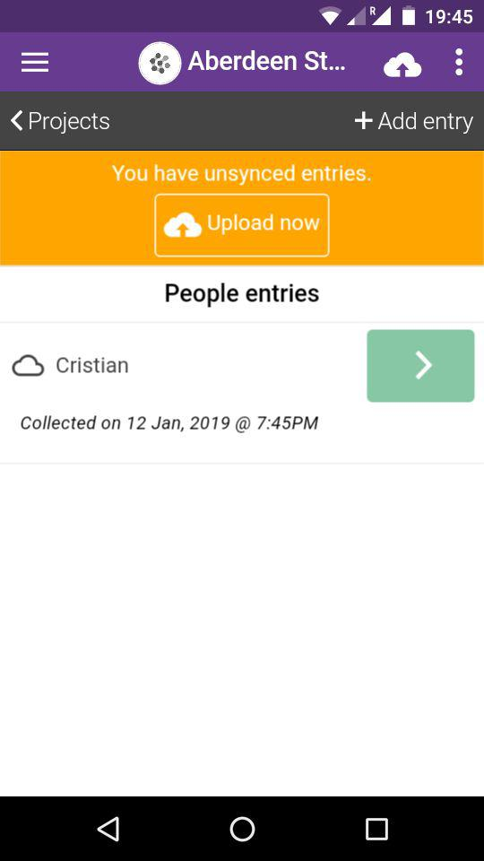
Recording & Uploading data

Slide 21
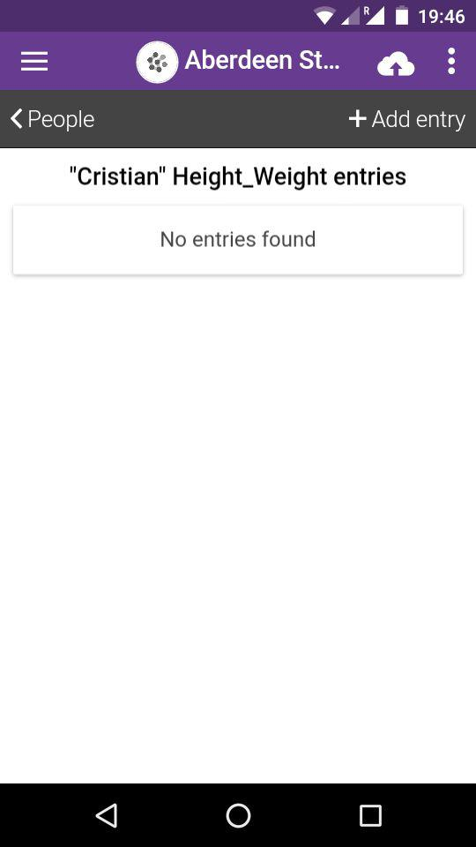
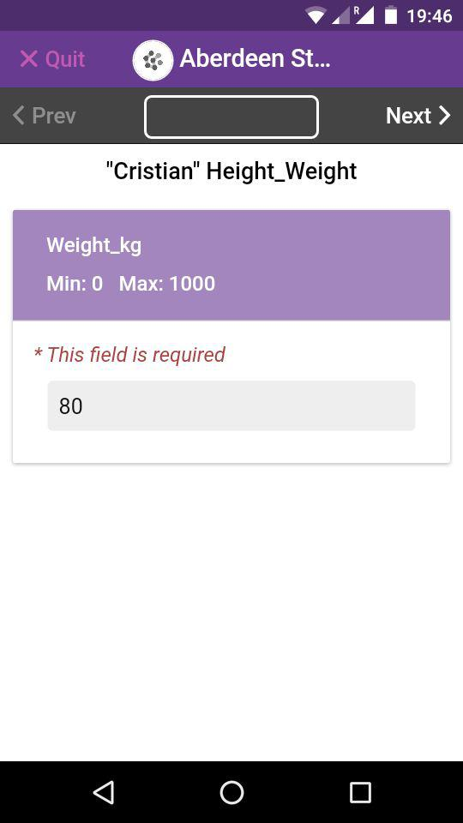
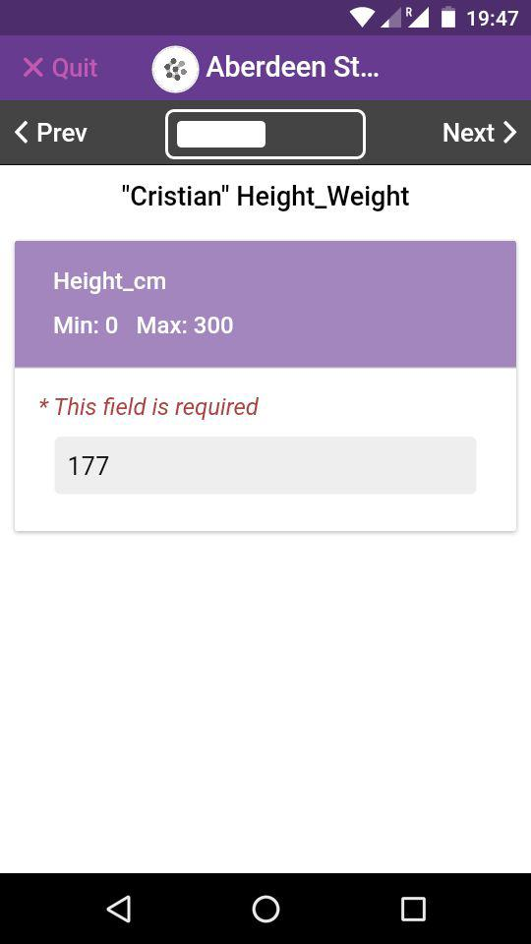
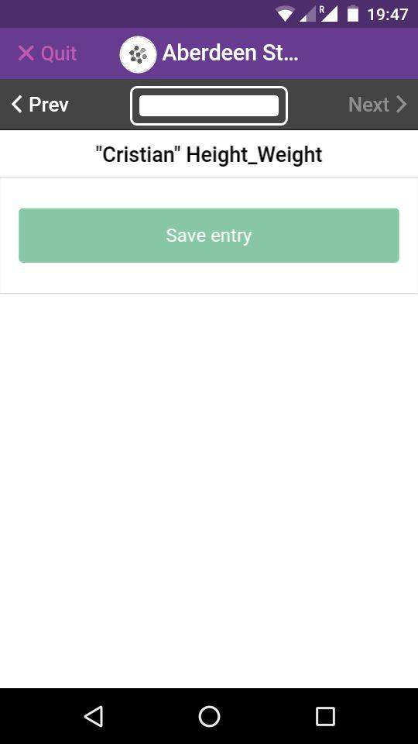
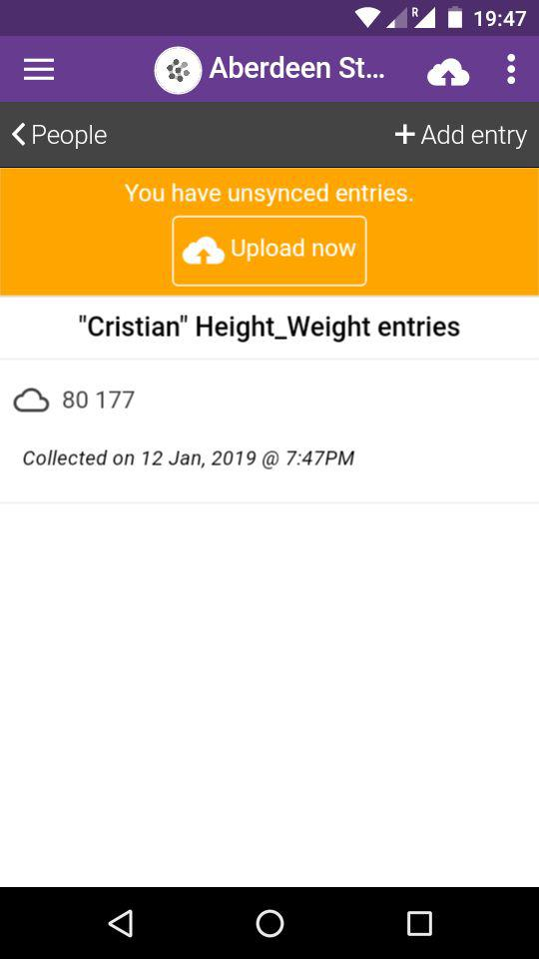
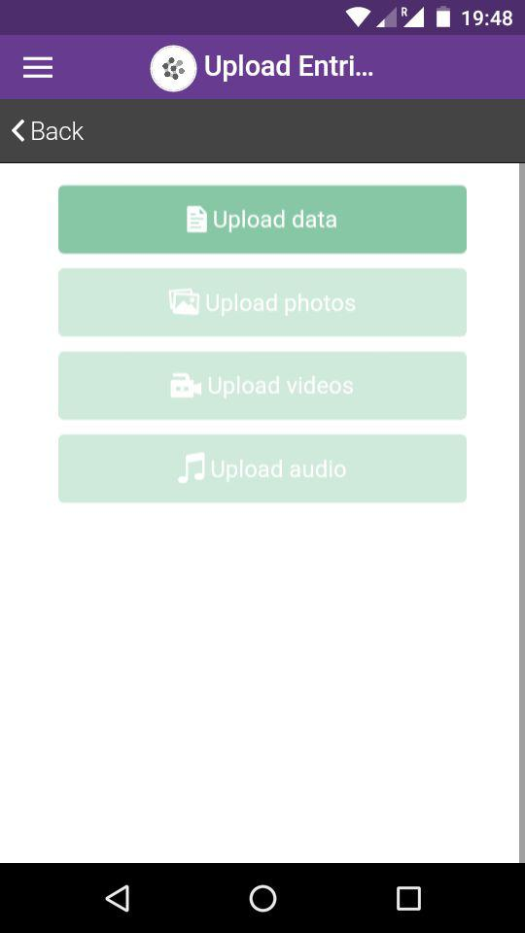
Recording & Uploading data

Slide 22
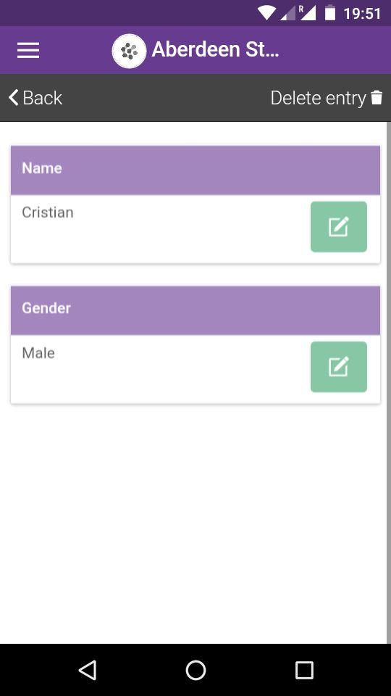
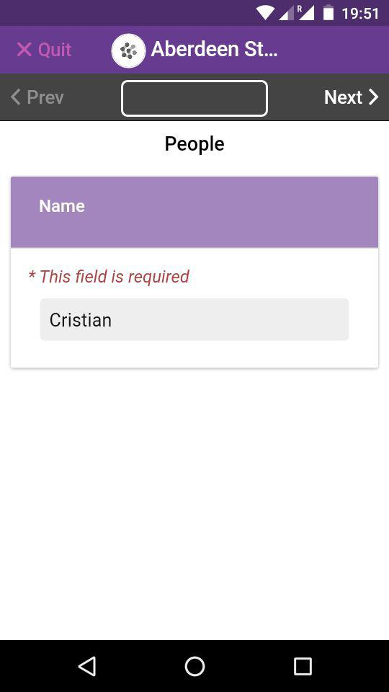
Edit entries

Slide 23
Your turn!

Slide 24
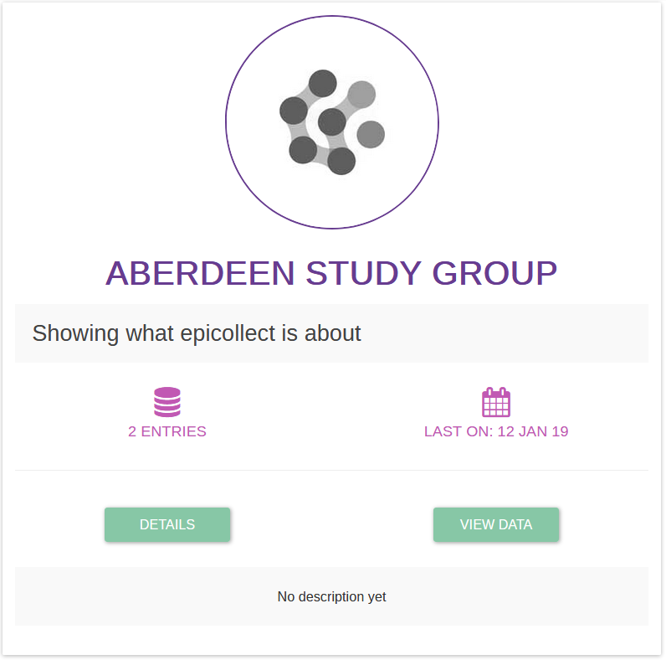
Downloading the data

Slide 25
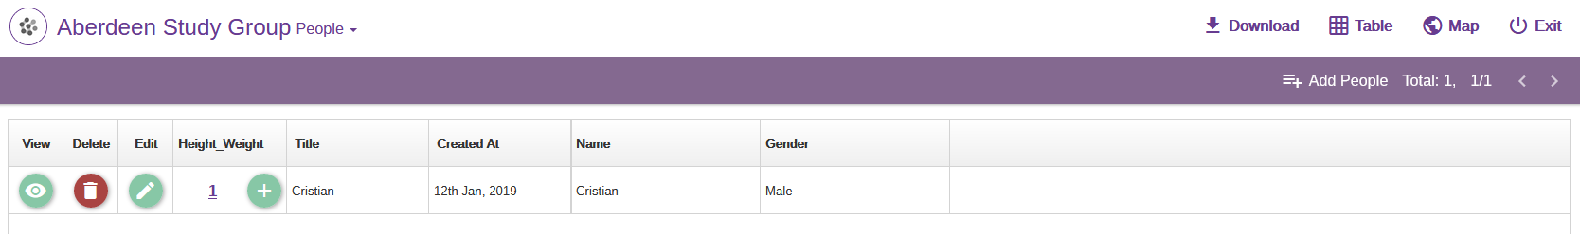
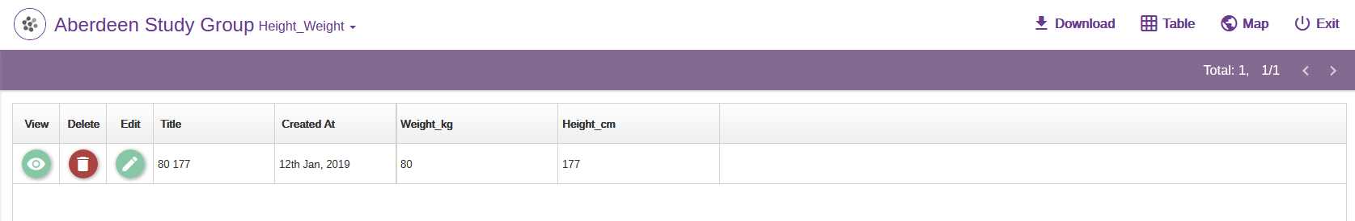

Slide 26
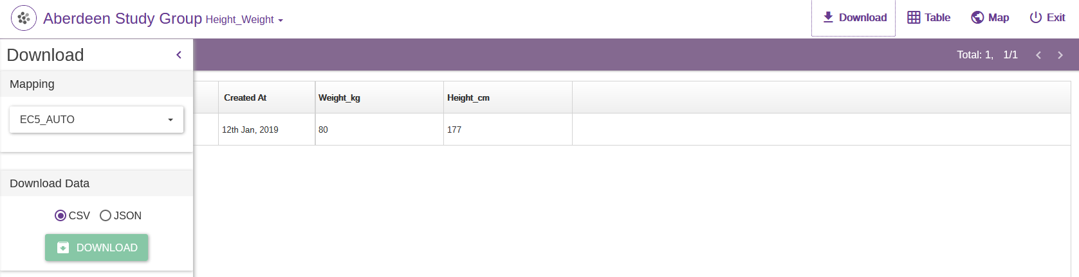
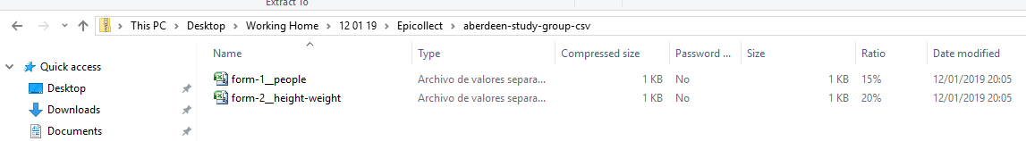

Slide 27

Unique Identifiers allow linking the two spreadsheets

Slide 28
Use R’s merge function to join forms
parent <- read.csv(‘file_path’, check.names=F)
child <- read.csv(‘file_path’, check.names=F)
tutorial <- merge(parent, child, by.x=‘ec5_uuid’, by.y= ‘ec5_parent_uuid’)

Slide 29
Other cool stuff that you can do
Record date and time, location, pictures,
Add jumps or groups of questions to forms
Map your data
Add collectors, curators...

Slide 30
Useful link
User guide: https://epicollect5.gitbooks.io/epicollect5-user-guide/content/

